Slide 1

AIMS 5740
Generative Artificial Intelligence
(2026 Term 2)
Computer Science & Engineering
The Chinese University of Hong Kong

Slide 2
Announcement
Our first assignment will be released on Feb 5. We will have a tutorial on Feb 4 for that.
Our course project will be released on late Feb. A team is suggested to have 3-4 people (maximum 4).

Slide 3
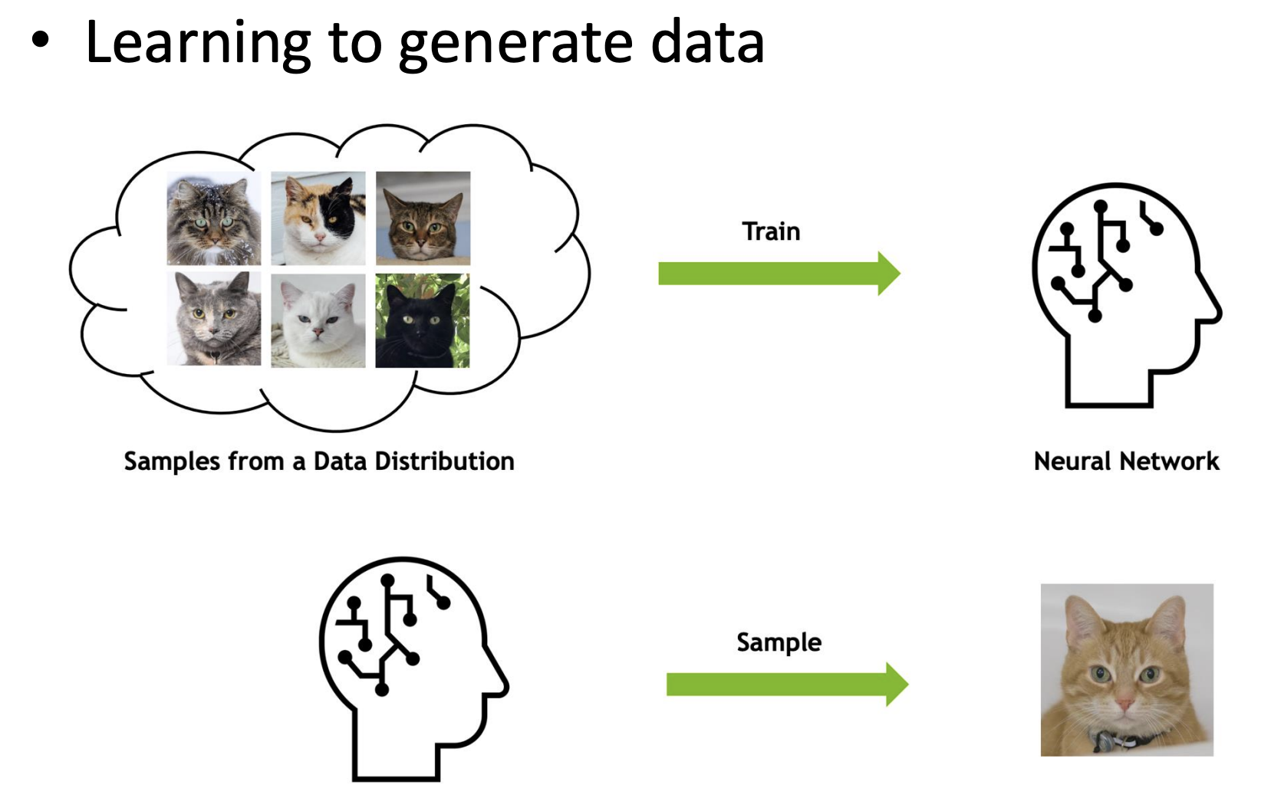
Generative Models

Slide 4
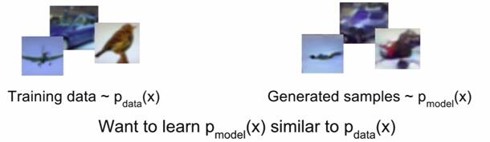
Generative Models
Given training data, generate new samples from same distribution
A core problem in unsupervised learning
Different flavors:
Explicit density estimation: explicitly define and solve for Pmodel
Implicit density estimation: learn model that can sample from Pmodel

Slide 5
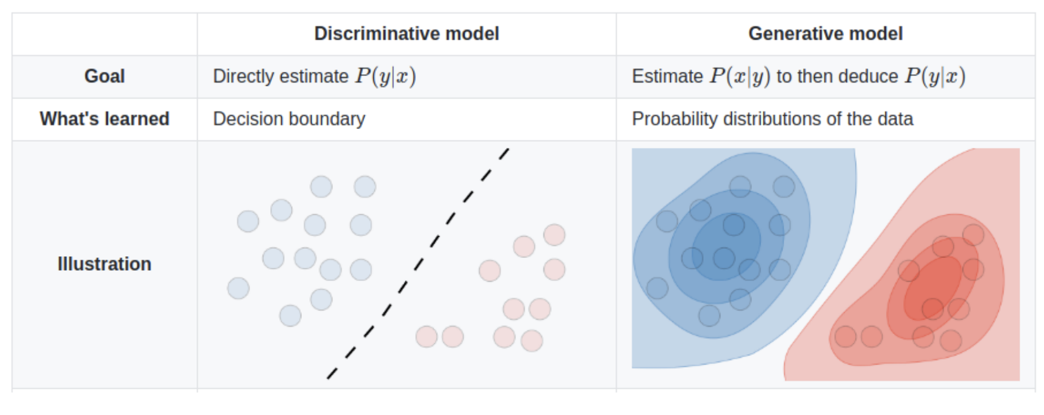
Generative vs. Discriminative

Slide 6

P(x|y) or P(y|x) ?
Cat?

Slide 7
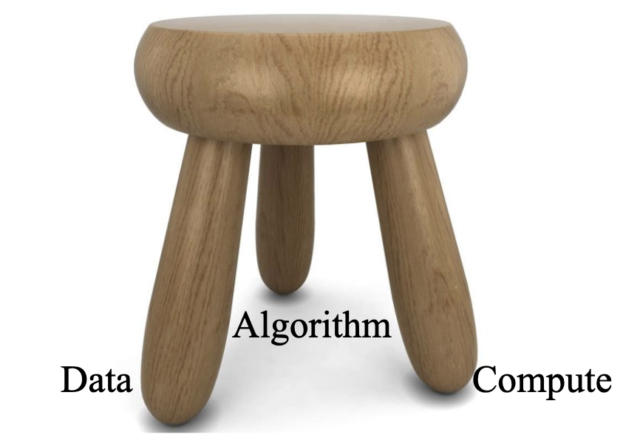
Generative AI
Data, algorithm and compute are three key components in the current generative AI applications.
4

Slide 8
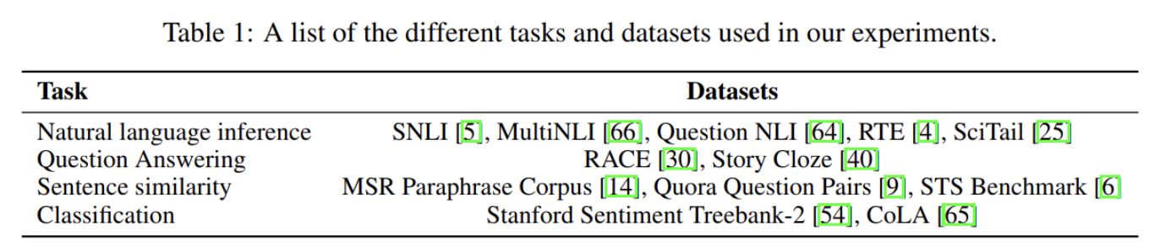
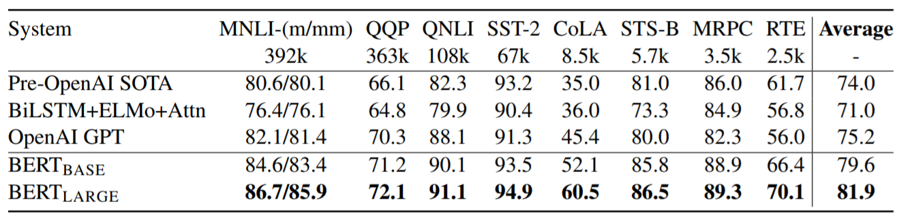
GPT
Transformer, Autoregressive modeling, 117 million parameters
Pre-training data: BooksCorpus and 1B word Benchmark
Fine-tuning data:

Slide 9
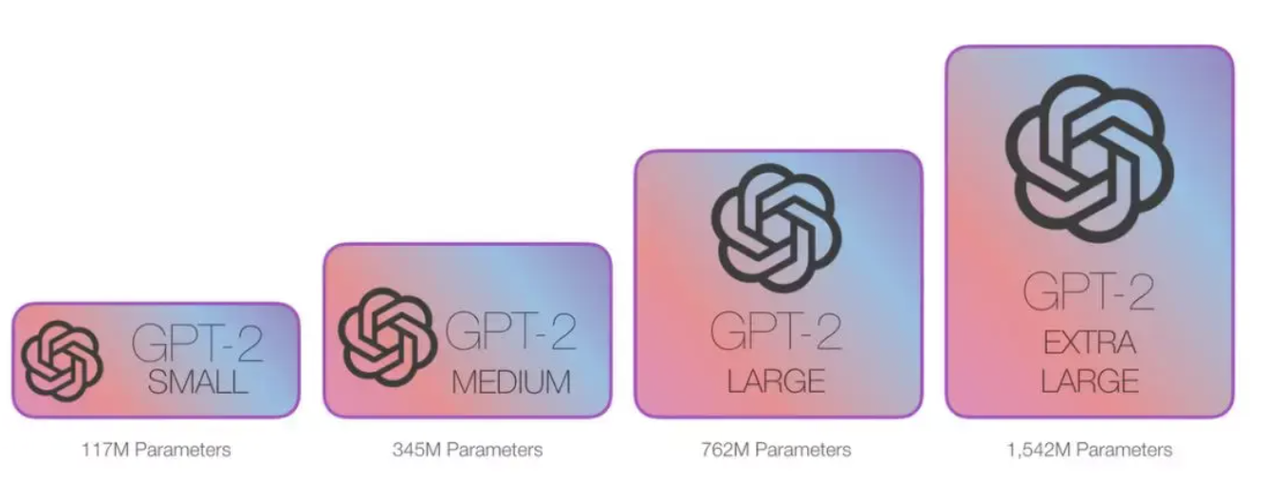
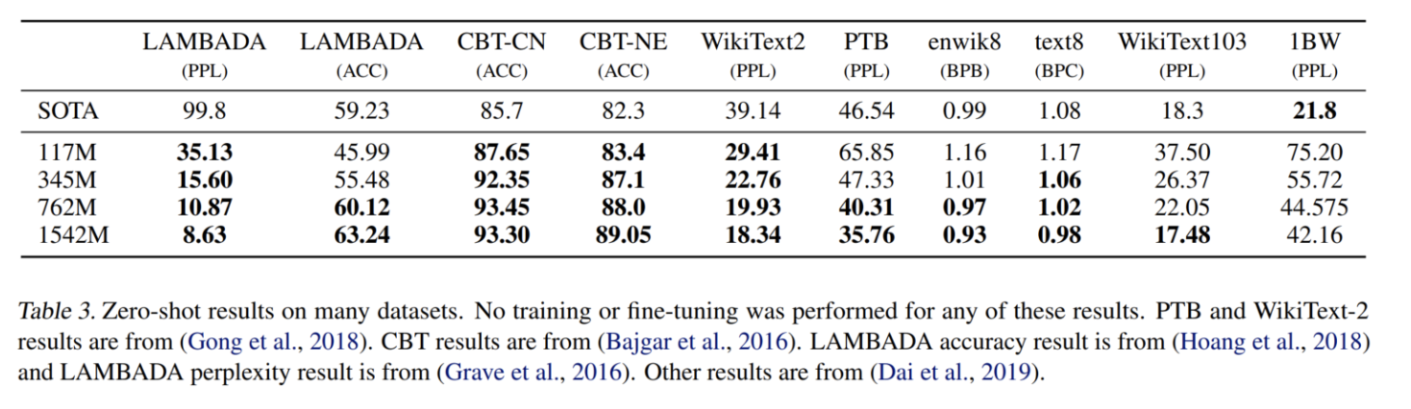
GPT 2
Pretraining data: a massive, diverse collection of over 40GB of text scraped from the web, specifically 8 million unique web pages from a dataset called WebText.

Slide 10
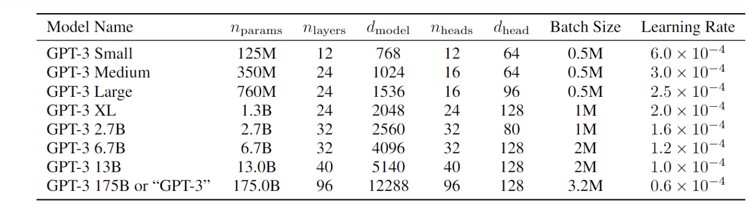
GPT 3
GPT-3 has 96 layers with each layer having 96 attention heads. The size of word embeddings was increased to 12888 for GPT-3 from 1600 for GPT-2. The context window size was increased from 1024 for GPT-2 to 2048 tokens for GPT-3.

Slide 11
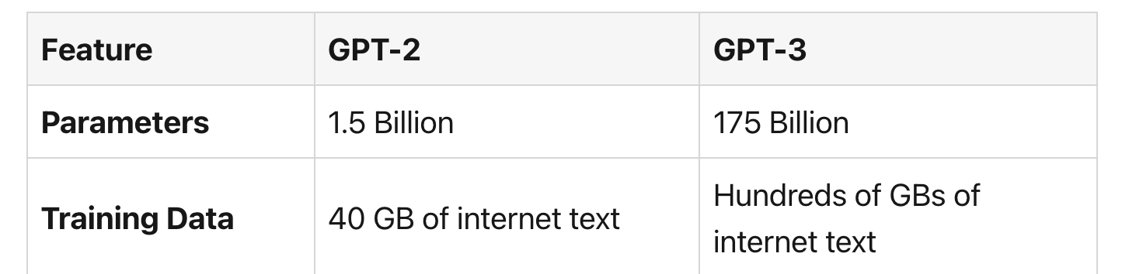
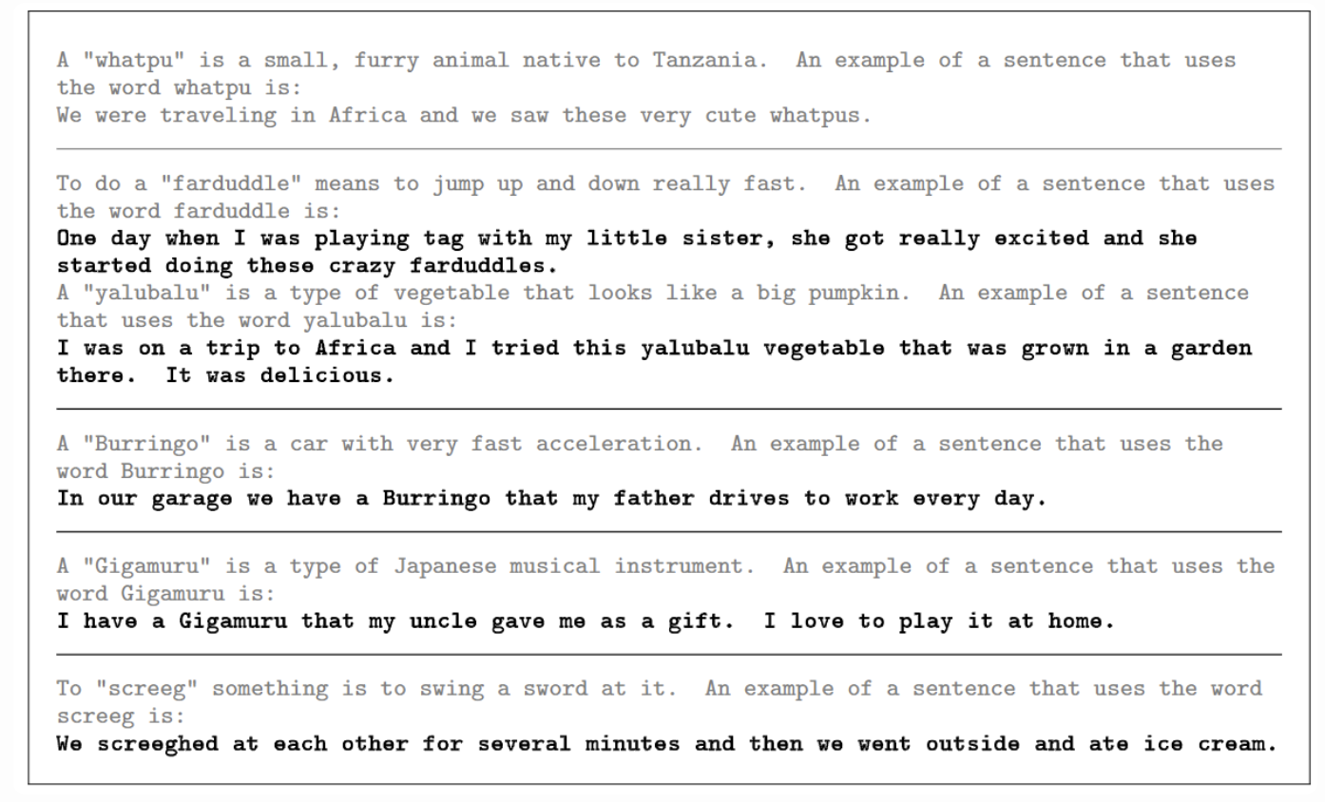
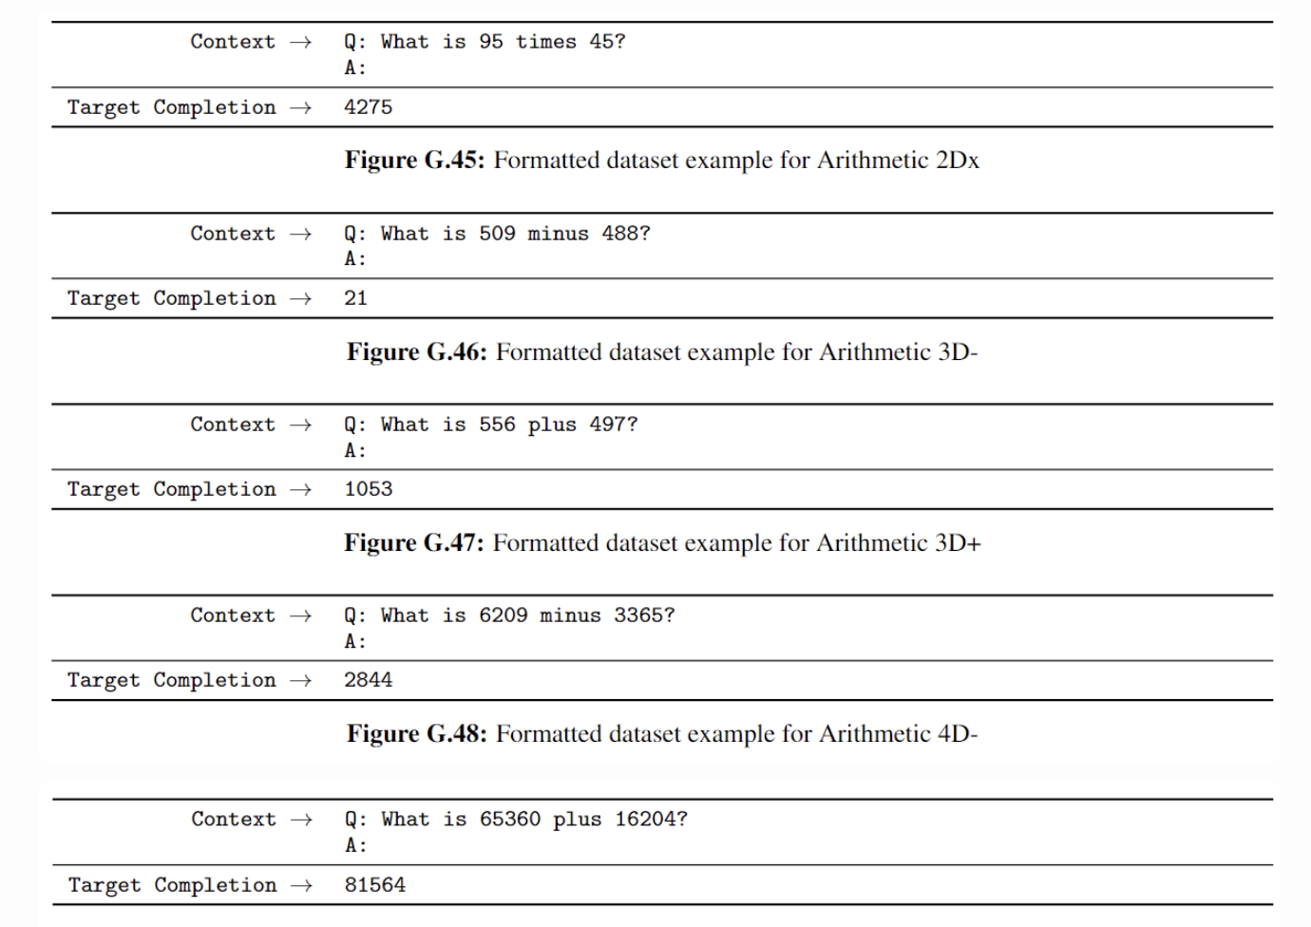
GPT 3

Slide 12
Generative AI
Data is one of the most key components for GenAI.

Slide 13
Pre-training Data for LLMs
Common crawl, snapshots of the entire web produced by the non- profit Common Crawl with billions of pages
Colossal Clean Crawled Corpus (C4; Raffel et al. 2020), 156 billion tokens of English, filtered What's in it? Mostly patent text documents, Wikipedia, and news sites
Professional data: BookCorpus, Exam (Stem, Liberal Arts), ProQuest, arXiv

Slide 14
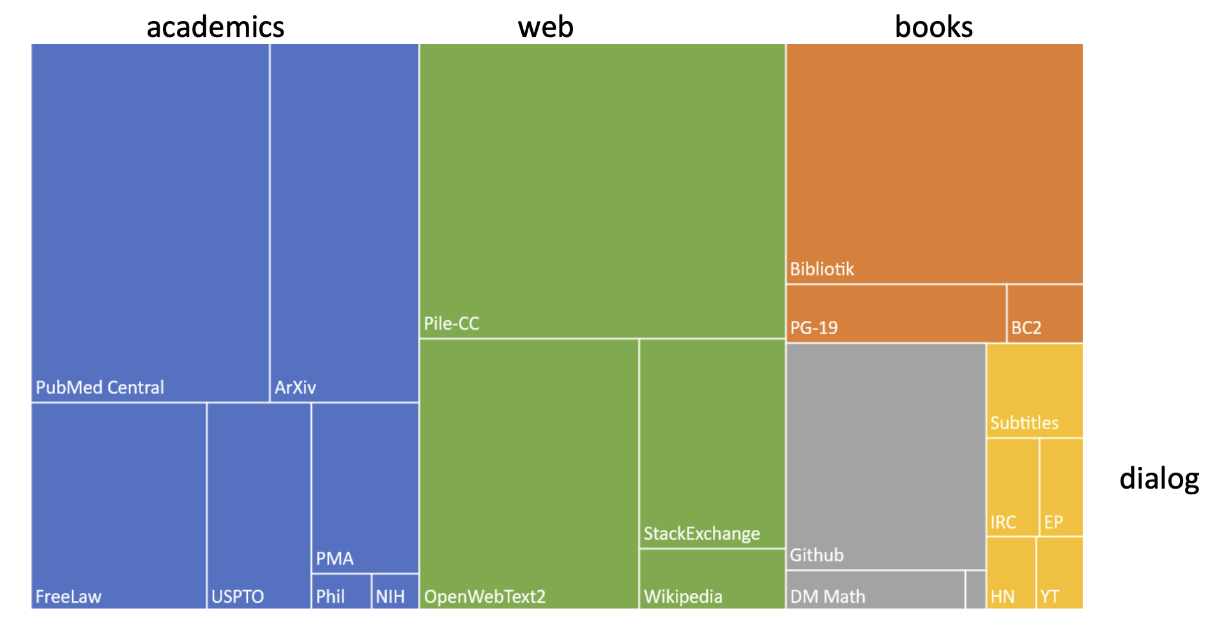
The Pile: a Pre-training Corpus

Slide 15
Issues of Web Data
Quality is subjective
• Many LLMs attempt to match Wikipedia, books, particular websites
• Need to remove boilerplate, adult content • Deduplication at many levels (URLs, documents, even lines)
Safety also subjective
• Toxicity detection is important, although that has mixed results
• Can mistakenly flag data written in dialects like African American English

Slide 16
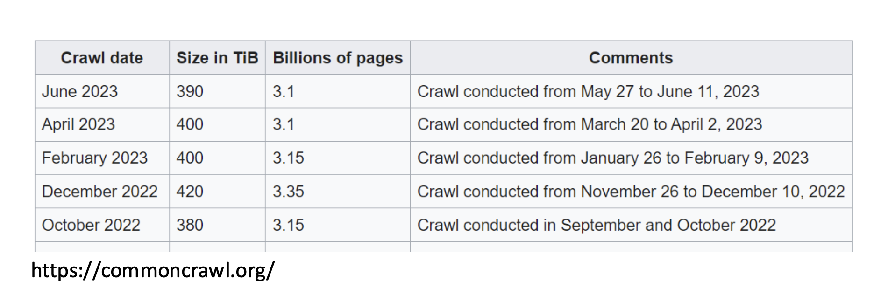
Issues of Web Data
Organization that crawls web and releases snapshots
• Still orders of magnitude below Google
• But really big!

Slide 17
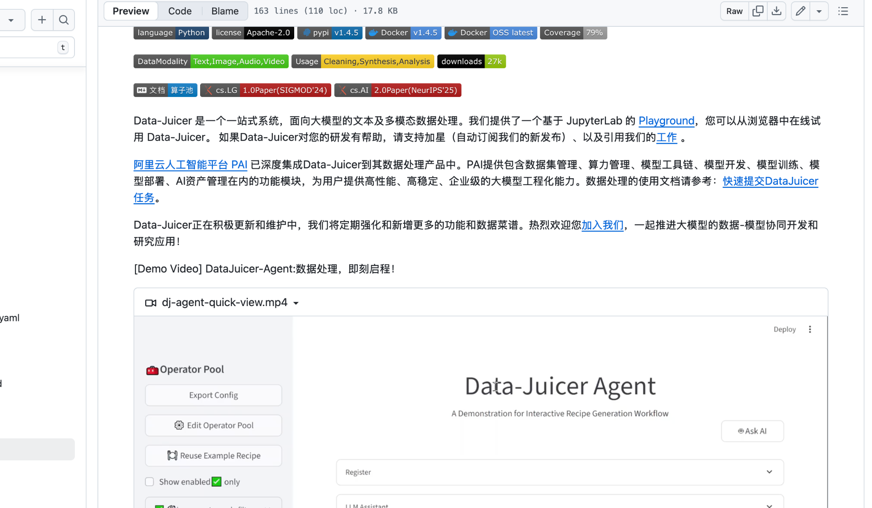
Web Data

Slide 18
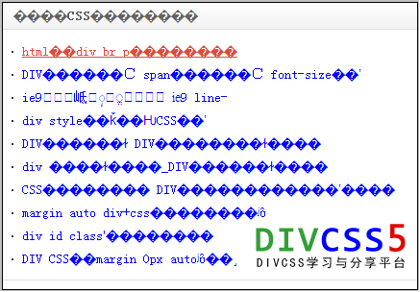

Processing Web Data (1)
• Detecting garbled, special characters
• Removing redundant and advertising content

Slide 19
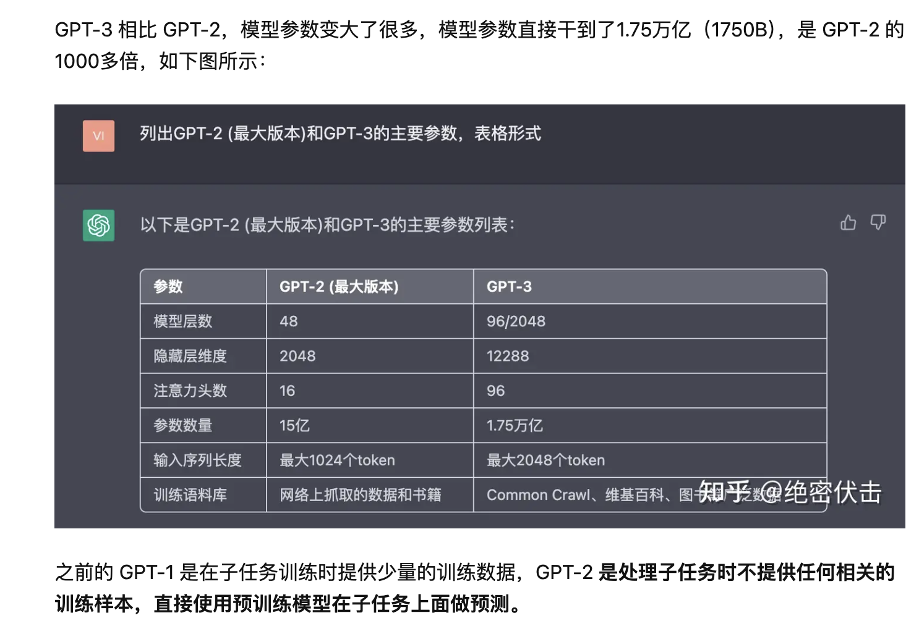
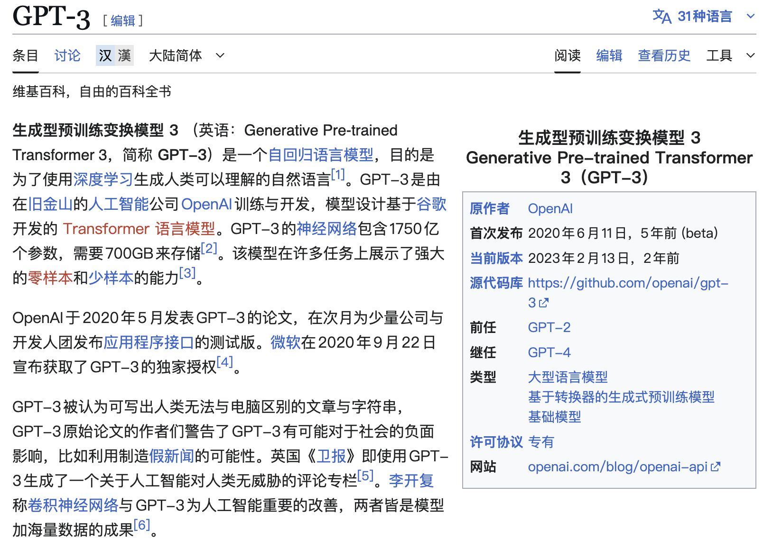
Processing Web Data (2)
• Need to process images, tables, and hyperlink
• How?

Slide 20
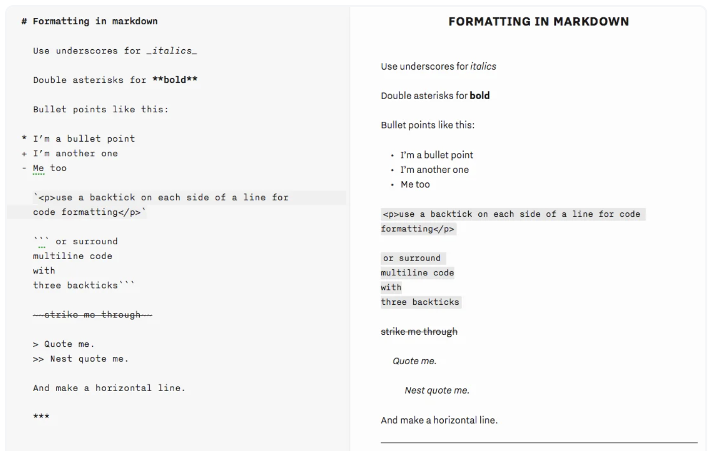
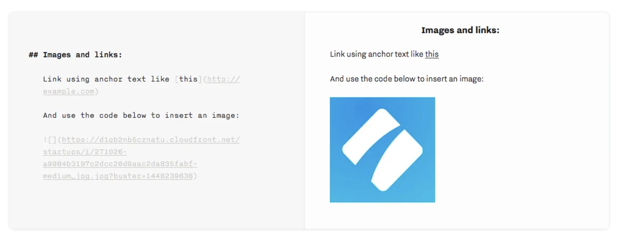
Processing Web Data (3)
• How? Captioning, OCR
• Hyperlink->crawling the new content

Slide 21
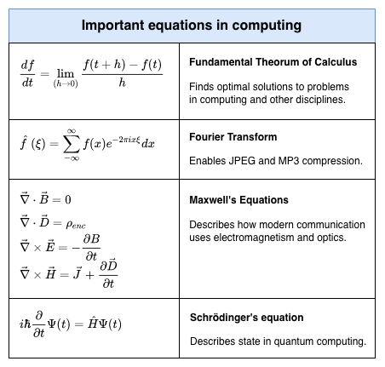
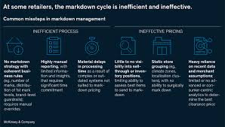
Processing Web Data (4)
• Structure format: markdown, title, subtitle
• Special symbols, math equations

Slide 22
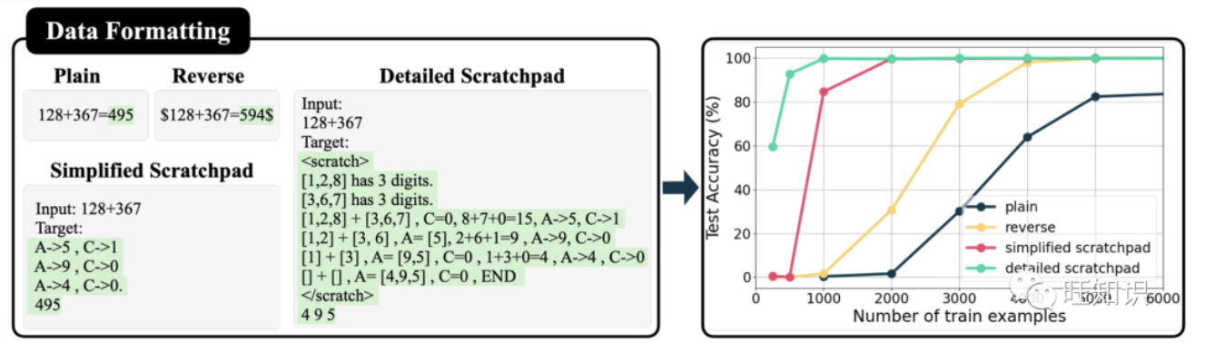
Data Format
• Different data formats can result in different learning speeds. Also note that they are the same data – the same equations, the same answers, just in different formats.

Slide 23
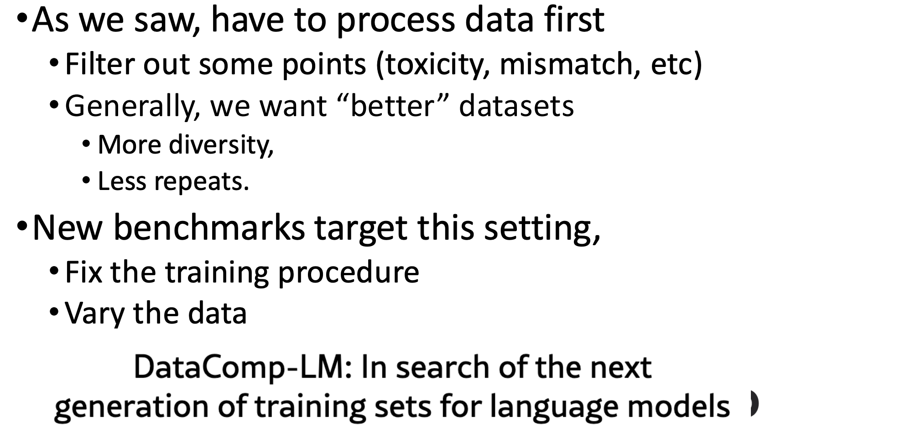
Data Filtering (1)

Slide 24
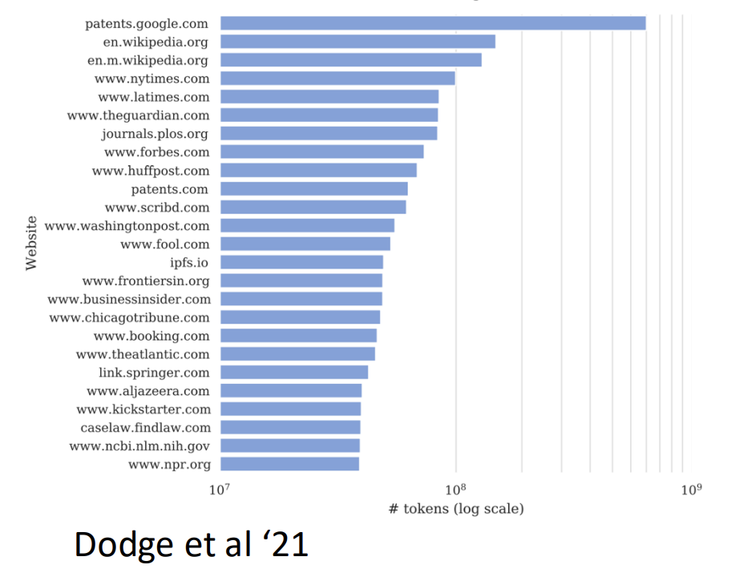
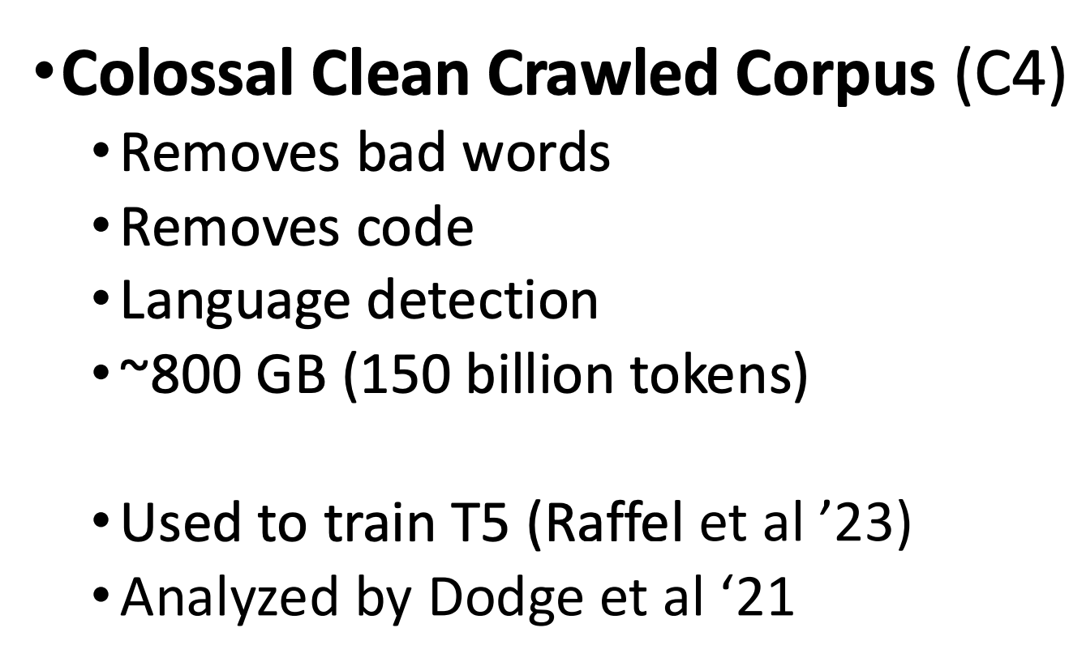
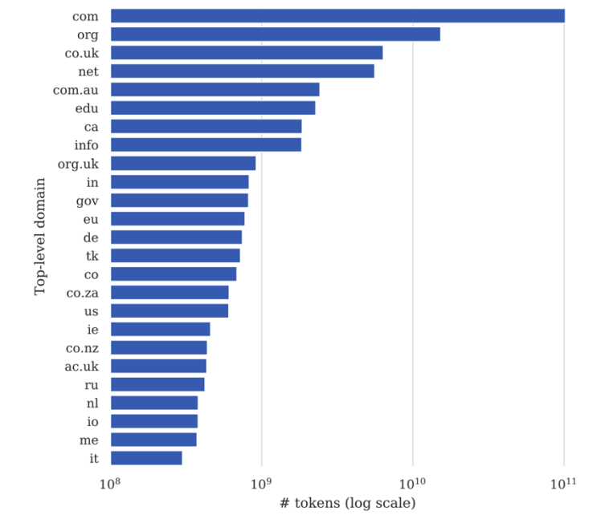
Data Filtering (2)

Slide 25
Redundancy Remove (1)
• Document level redundancy
Template string filter: Identifies and removes text containing excessive template content.
• Sentence level redundancy
N-gram repetition filter: Identifies repeated phrases of varying lengths and removes documents with excessive repetition, which may indicate poor content quality or artificial generation.
Semantic deduplication is particularly important for identifying paraphrased content, translated versions of the same material, and conceptually identical information

Slide 26
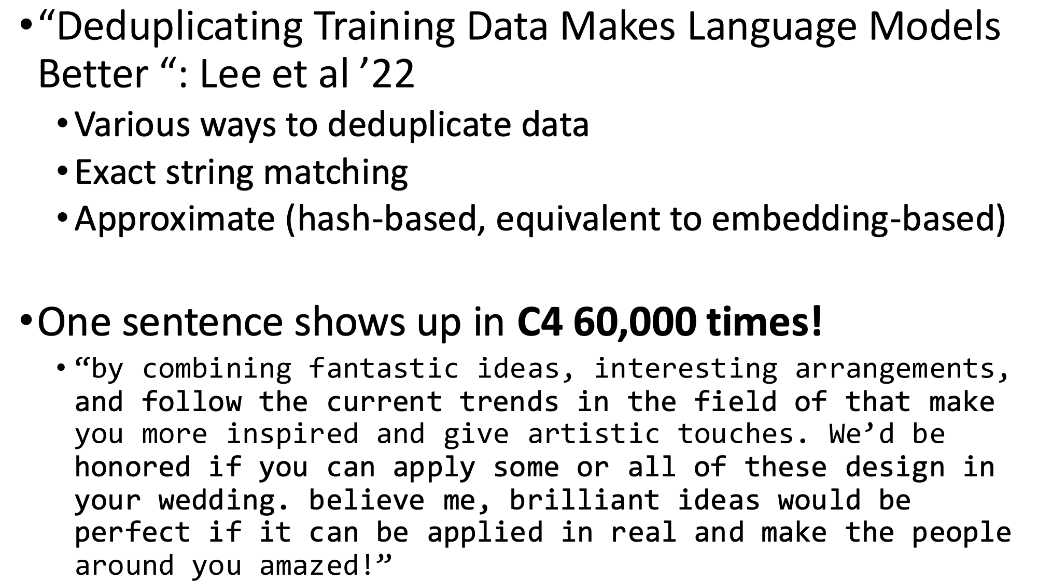
Redundancy Remove (2)

Slide 27
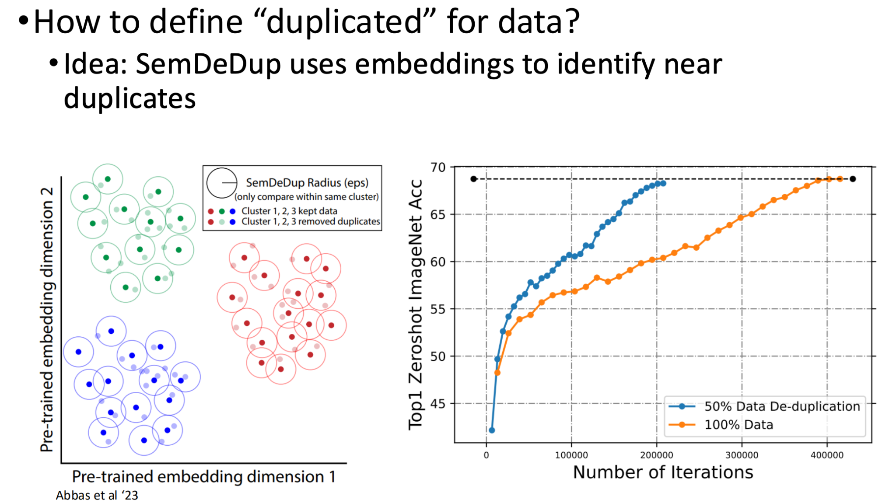
Redundancy Remove (3)

Slide 28
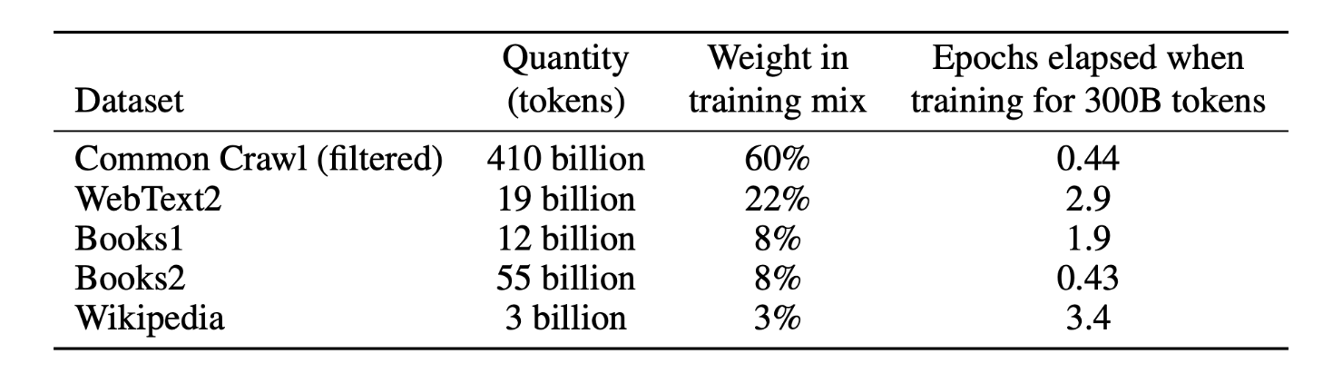
Model-based Data Selection (1)
• “High quality” data usually takes up a small percent
• How can we do data selection for low quality data

Slide 29
Model-based Data Selection (2)
• Use Wiki and Books data as the positive samples, and train a classifier (e.g. Bert)
• Use this classifier to select data from CC

Slide 30

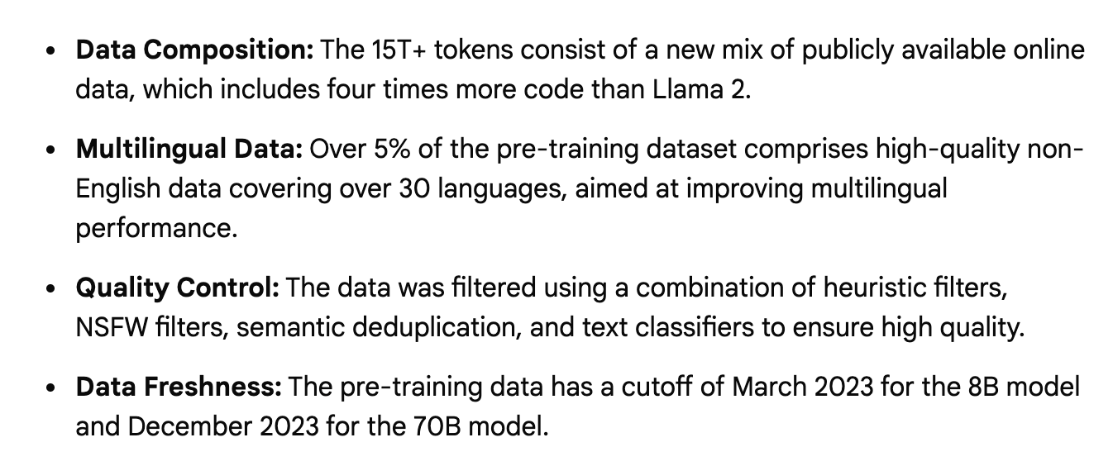
Model-based Data Selection (3)
• Llama 3 pretraining data
• Use Llama 2 as the classifier to select the data

Slide 31
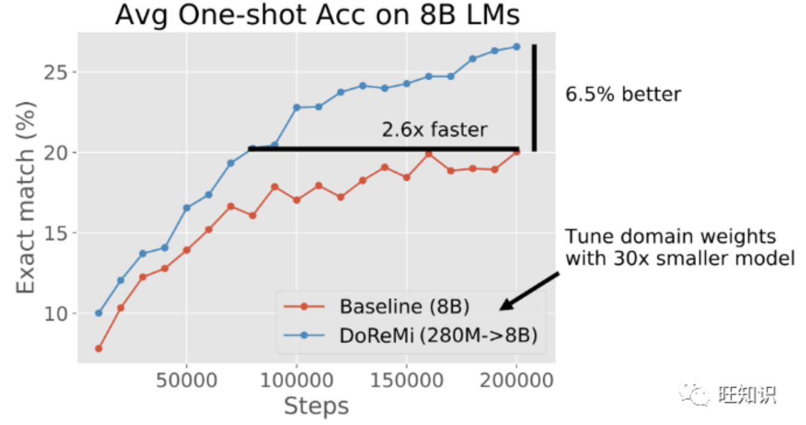
How to Mix your data (1)
• Different mixing ratios may result in different learning speeds.

Slide 32
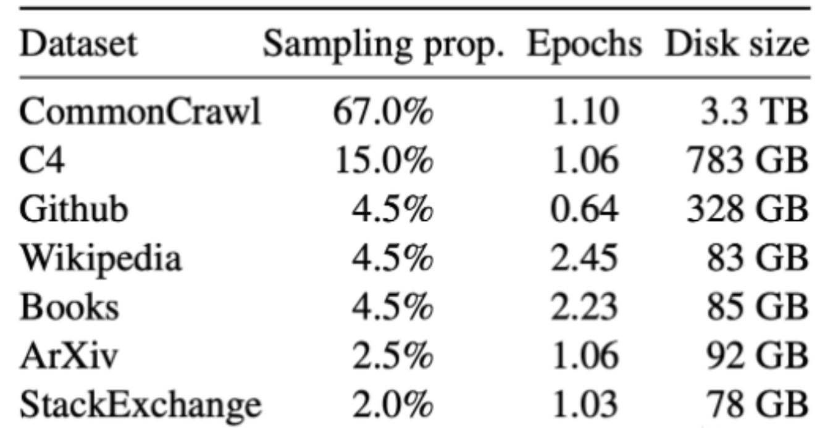
How to Mix your data (2)
• The code data is similar to that on GitHub, so LLaMA's coding performance isn't very high. In contrast, starcoder, which is primarily trained on code, performs well on coding tasks.
• The data is similar to that on papers like Arxiv, so LLaMA's scientific inference performance appears to be relatively low. In contrast, Galactica, which is primarily trained on papers, performs well in scientific inference.

Slide 33
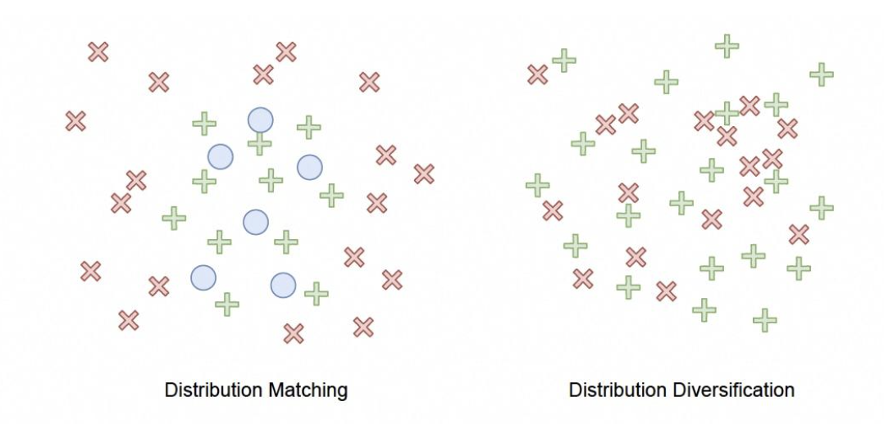
How to Mix your data (3)
• Distributed learning methods prioritize sample heterogeneity and remove redundant data. The goal is to improve training efficiency and reduce bias.
• Diversity is required for both sample and category levels.

Slide 34
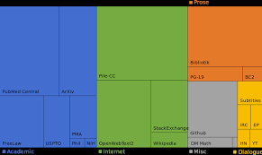
How to Mix your data (4)
• Relying on intuition (or experiences): Improving the weights of domains with higher quality (potentially edited).
• Relying on downstream tasks: Adjusting domain weights based on performance on downstream tasks, training many models in zero-order optimization algorithms or heuristic search strategies.

Slide 35
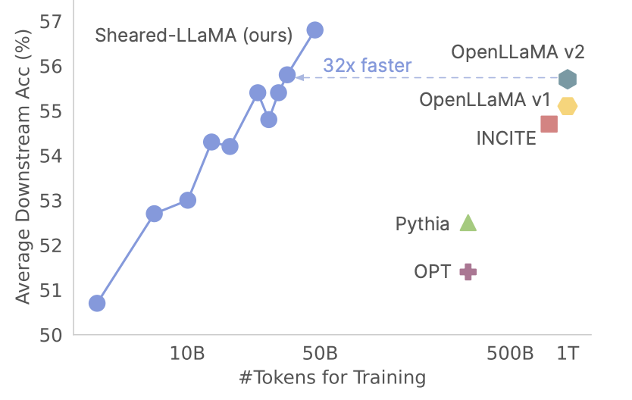
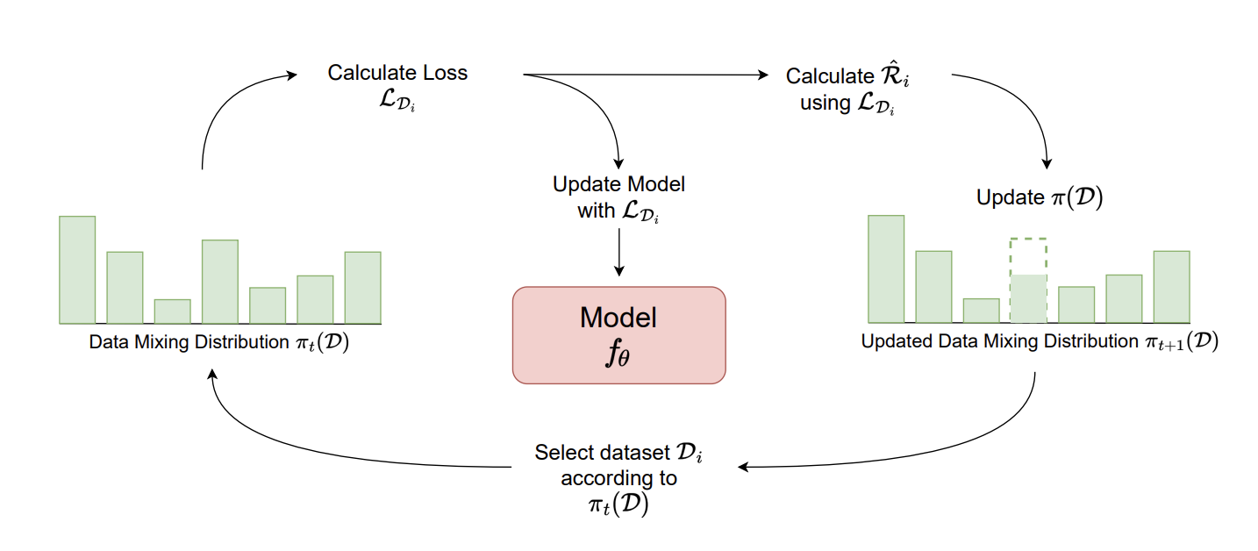
How to Mix your data (5)
• Online method: Online Data Mixing (ODM) that combines elements from both data selection and data mixing, optimizing the data mixing proportions during training.

Slide 36
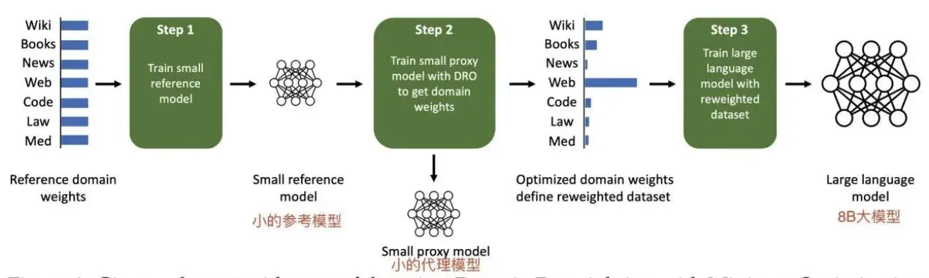
How to Mix your data (6)
• Offline method: trains a small proxy model over domains to produce domain weights (mixture proportions) without knowledge of downstream tasks. Then resample a dataset with these domain weights and train a larger, full-sized model.

Slide 37
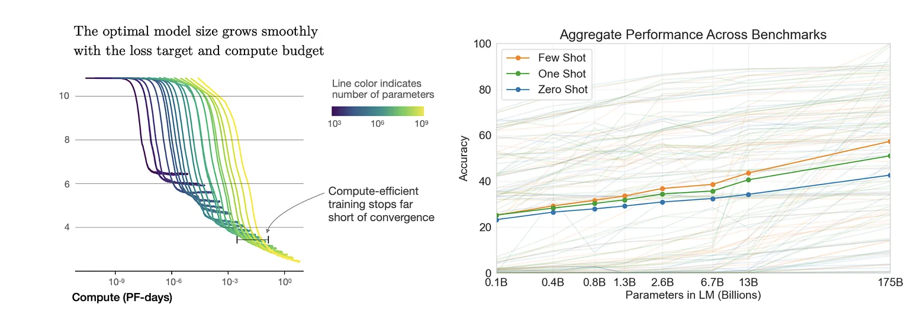
Model Scaling (1)
• Can we use the results from small models to guide the design of large models?
• Yes, we have Scaling Laws. OpenAI reports that during the development of GPT-4, they predicted the performance of HumanEval before the experiment.

Slide 38
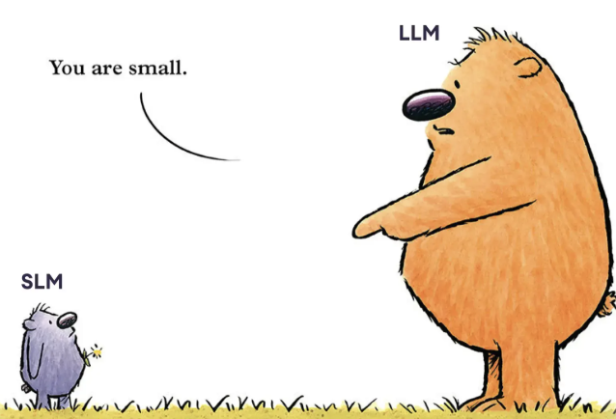
Model Scaling (2)
• Can we use the results from small models to guide the design of large models?
• No, some observations can not be transferred from small models to large models. (e.g., 7B vs. 70B)

Slide 39
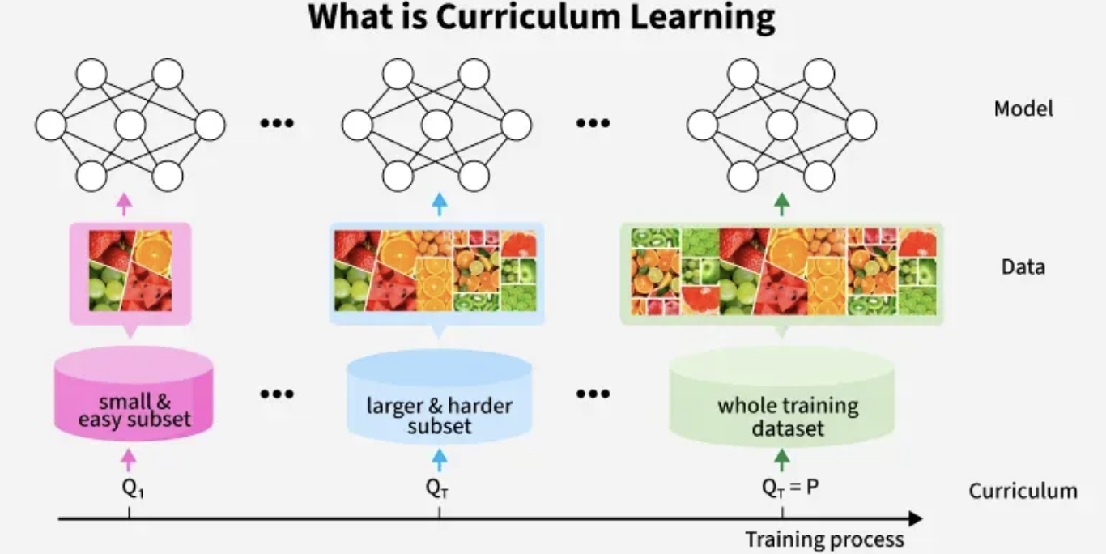
Data Curriculum (1)
• We aim to teach the model many skills, such as math and coding.
• Different training data sources exist to aid each skill (e.g., web pages for MMLU-type problems, GitHub resources for coding problems).

Slide 40
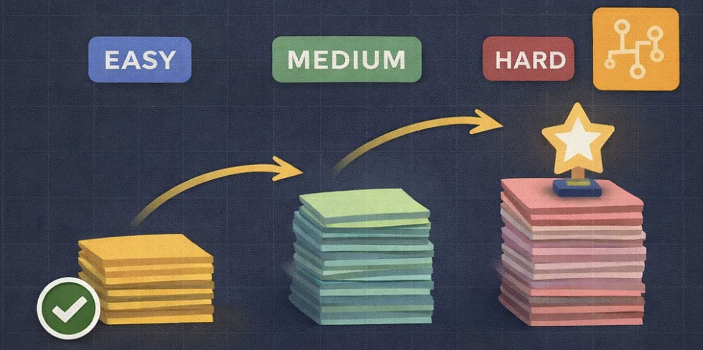
Data Curriculum (2)
• Method 1 (Code Only): Directly feed 10B code data
• Method 2 (Uniform Mixing): Uniformly mix 5B text and 5B code data, then input them into the model simultaneously.
• Method 3 (Data Curriculum): Input 5B text first, then input 5B code.

Slide 41
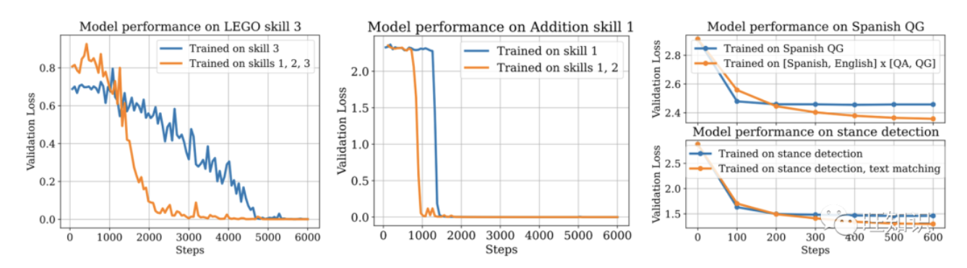
Data Curriculum (3)
• If the skills learned by the model from text data are not helpful for code data, then we can use 1, as in the cases of StarCoder and AlphaCode.
• If the skills learned by the model from text data can be transferred to code data, then we might want to do 2, uniform mixing.
• If learning code skills requires the model to already have text skills, and the text must come first—then we need to do 3, data-based learning. Codex and CodeLLaMA are examples of this.

Slide 42
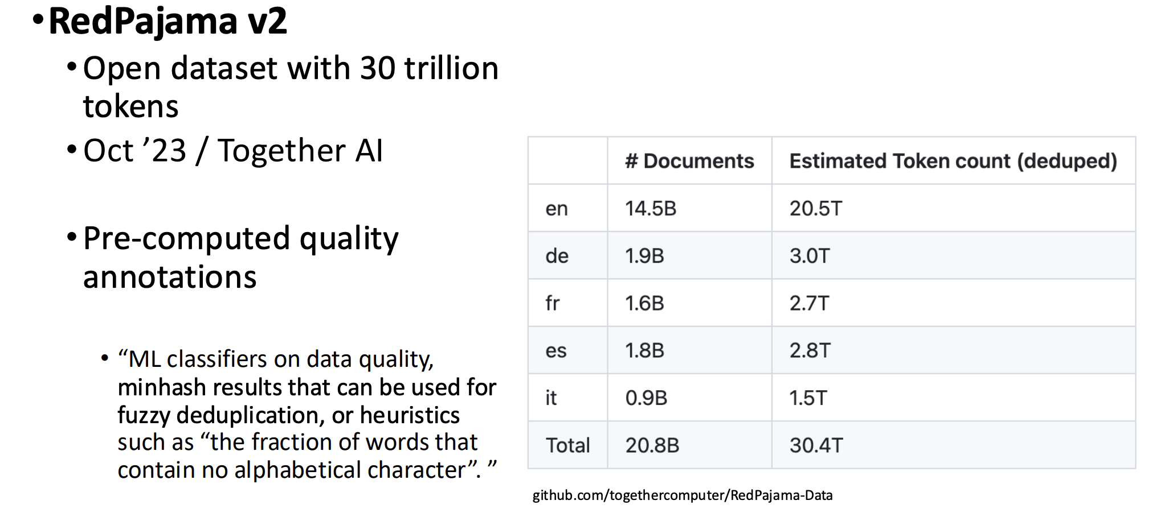
Places to Get Data: RedPajama

Slide 43
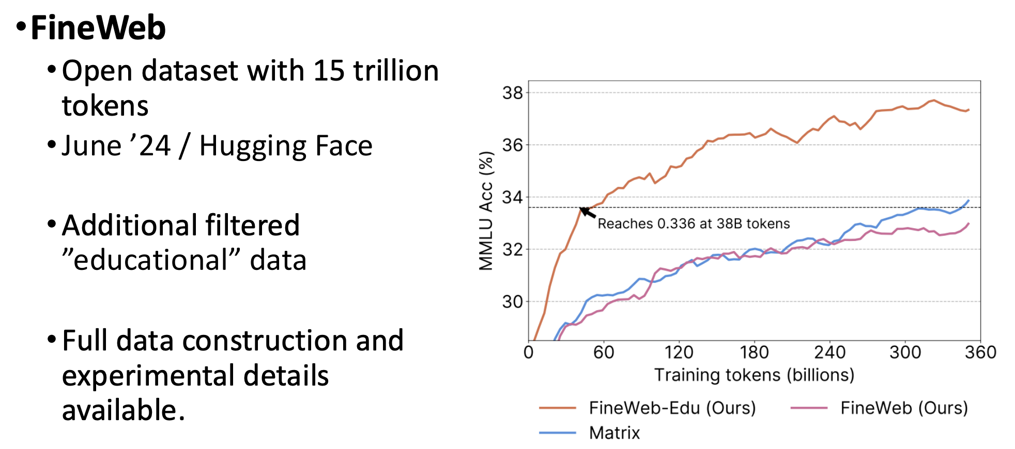
Places to Get Data: FineWeb

Slide 44
Scraping from the Web
• Copyright: much of the text in these datasets is copyrighted
Not clear if fair use doctrine in US allows for this use
This remains an open legal question
• Data consent
Website owners can indicate they don't want their site crawled
• Data Privacy
Websites can contain private IP addresses and phone numbers

Slide 45
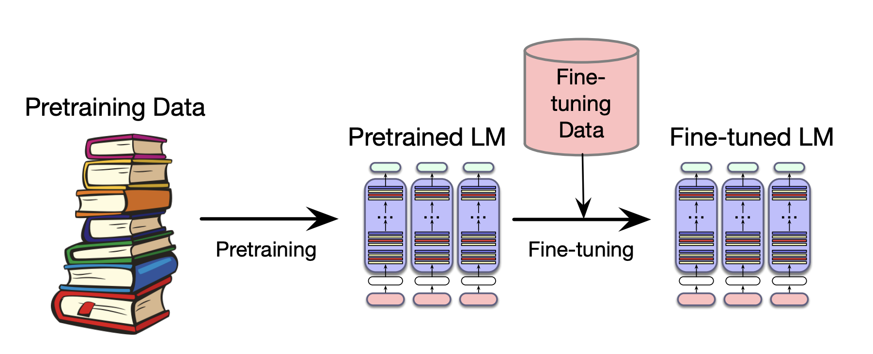
Fine-tuning (Post-training)
• What happens if we need our LLM to work well on a domain it didn't see in pretraining? Perhaps some specific medical or legal domain?

Slide 46
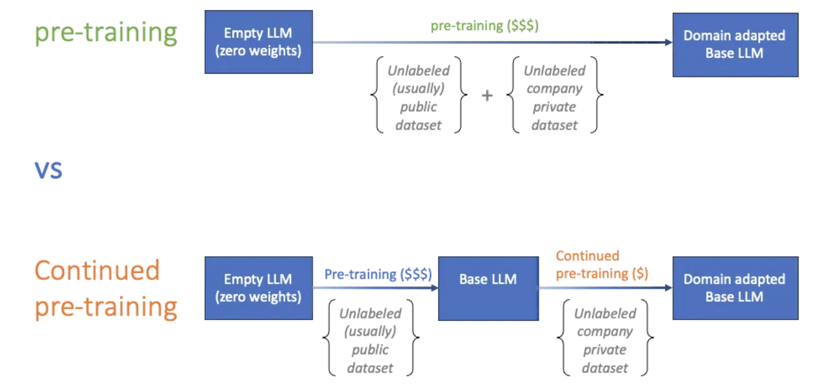
Fine-tuning (Post-training)
• Taking a pretrained model and further adapting some or all of its parameters to some new data
• Hence sometimes called continued pretraining

Slide 47
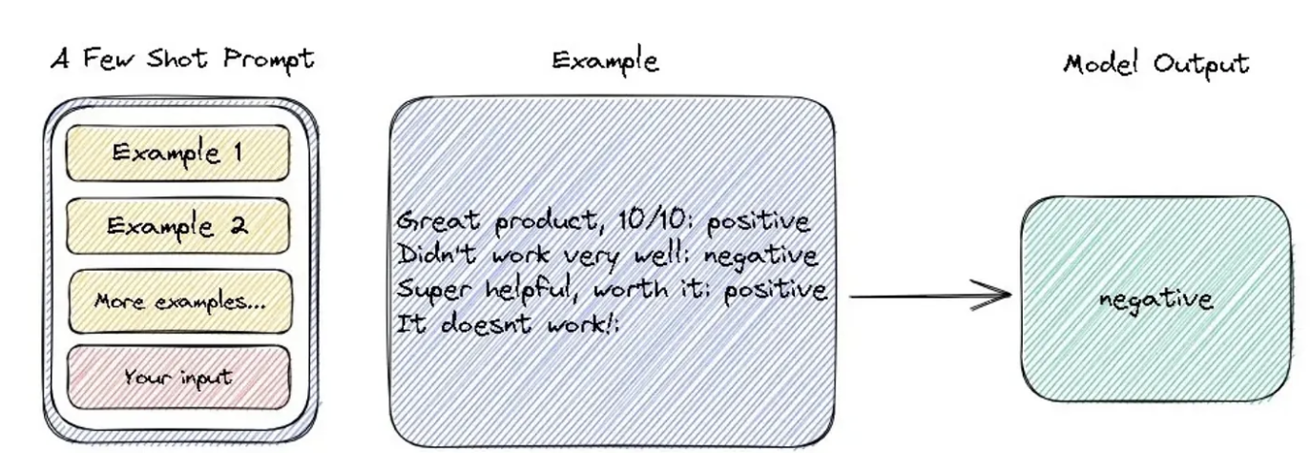
Few-shot Learning
• A machine learning approach that enables a model to generalize and make accurate predictions after being trained with only a small number of labeled examples per class

Slide 48
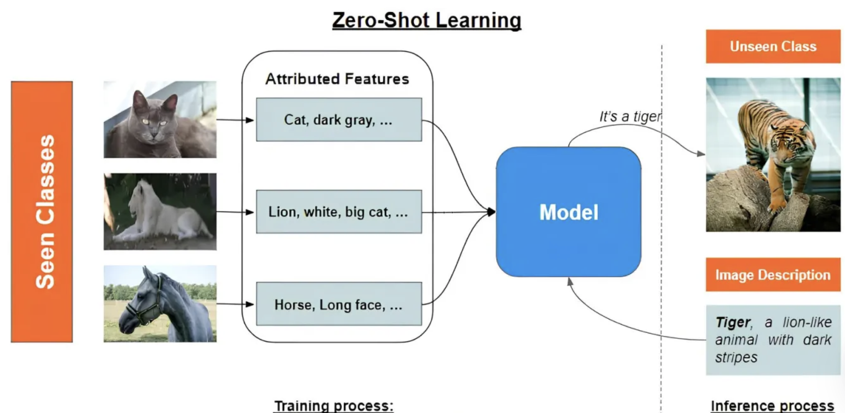
Zero-shot Learning
• Zero-shot learning (ZSL) is an AI technique where models classify or understand new data/tasks they weren't explicitly trained on.

Slide 49
Where do we use FT?
• Vertical Enhancement: Enhances the general-purpose expertise of large models, such as in healthcare, law, and finance.
• Task Specialization: Optimizes for specific scenarios and tasks, such as question answering systems, text classification, and named entity recognition.
• Language Localization: Adapts models primarily trained on English or Chinese to other languages.
• Tone and Style Adjustment: Adjusts the model's output style to better match specific expressions or tones.
• Security Enhancement: Reduces the likelihood of the model generating harmful or inappropriate content through fine-tuning.

Slide 50
How to collect FT data?
• Web data + manual rewriting: after the data is crawled, it usually needs to be manually reviewed and rewritten to ensure data quality and applicability.
• Production data + manual rewriting: data may come from closed-source LLM responses and may lack the characteristics of real human conversations.
• Social media data + manual rewriting: when exporting to social media platforms, it is important to handle issues involving privacy information (PII), such as name, ID number, and phone number.
• Public dataset: By making good use of these public datasets, we can provide the model with rich role-playing training materials, thereby improving the model's dialogue ability and role performance.

Slide 51
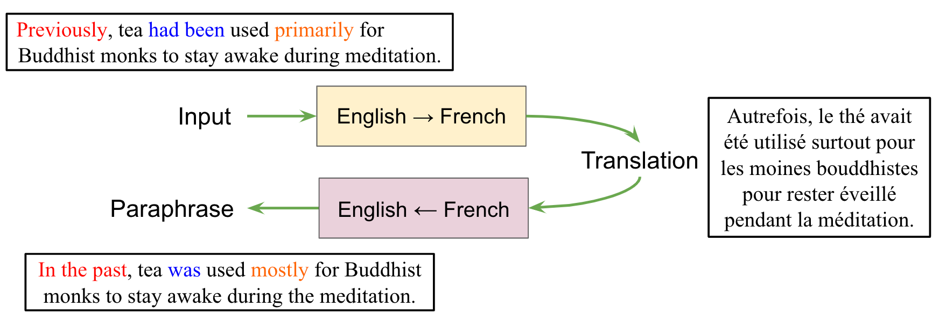
FT Data Augmentation (1)
• Synonym Substitution: Using a thesaurus or pre-trained word embedding models, replace certain words in a sentence. This method can increase linguistic diversity while preserving the original semantics.
• Back Translation: Translate the original text into another language and then back. This method can generate different sentence structures expressing the same meaning.

Slide 52
FT Data Augmentation (2)
• Contextual Expansion: Add more contextual information to existing dialogues, making them richer and more natural.
• Sentence Restructuring: Break long sentences into shorter sentences, or combine multiple short sentences into longer sentences, increasing the diversity of sentence structures.
• Text Generation: Utilize existing large language models to generate new and similar text. This method can generate a large amount of new data, but it requires careful control of the quality and relevance of the generated content.

Slide 53

Data Augmentation with LLMs (1)
content expansion

Slide 54

Data Augmentation with LLMs (2)
scenario change

Slide 55

Data Augmentation with LLMs (3)
style transfer

Slide 56

Instruction Data (1)
• The purpose of instruction fine-tuning is to enable the model to better understand and execute human-provided instructions, to significantly improve zero-shot capability for unseen tasks.

Slide 57

Instruction Data (2)
•The language model performs supervised fine-tuning on this data, taking the task instructions and input as inputs to the language model to generate the corresponding output.

Slide 58

Instruction Data (3)
•The language model performs supervised fine-tuning on this data, taking the task instructions and input as inputs to the language model to generate the corresponding output.

Slide 59

Instruction Data (4)
• As the model size and the number of instruction tuning tasks increase, the model performance gradually improves. When the number of tasks exceeds 282, the model performance does not change significantly.

Slide 60

Instruction Data (5)
•Including COT data can improve model inference capabilities and further unlock zero-shot capabilities. Furthermore, instruction tuning without COT data will negatively impact performance on COT datasets, while instruction tuning with a mix of COT and non-COT data will result in models that perform well.

Slide 61

Data Efficiency (1)
• How many fine-tuning data we really need?
• LIMA: Less Is More for Alignment - measure the relative importance of these two stages by training LIMA, a 65B parameter LLaMa language model fine-tuned with the standard supervised loss on only 1,000 carefully curated prompts and responses.

Slide 62

Data Efficiency (2)
•Training a model on a task where the prompt is uncertain will improve its ability to associate the prompt with a specific underlying concept (task), thus achieving better zero-shot performance when the prompt is not seen (easy, ambiguous, difficult).

Slide 63

Data Efficiency (3)
• A proactive instruction tuning method based on Prompt Uncertainty. This method estimates uncertainty by evaluating the degree of inconsistency between the model and the original prediction given complete and perturbed task instructions.

Slide 64

Forms of Data: Alignment Data

Slide 65

Forms of Data: Instruction Tuning

Slide 66

Forms of Data: Instruction Tuning

Slide 67

Multimodal Data (1)
• Contextual understanding: Allows AI to grasp complex real-world scenarios by seeing, hearing, and reading simultaneously.

Slide 68

Multimodal Data (2)
• Key points of multimodal data: 1) quality of the single modal data; 2) joint content of the two/three modalities; 3) detailed information.

Slide 69


Multimodal Data (3)
• Image: removing blurry images, duplicates, increasing diversity;
• Text: all the methods mentioned in our previous slides
BLIP

Slide 70


Multimodal Data (4)
• Detailed captions.

Slide 71


Multimodal Data (5)
• Image captioning hallucination.

Slide 72

Multimodal Data Resource
• CC3M

Slide 73

Multimodal Data Resource
• Web Image-Text-1B

Slide 74

Multimodal Data Resource
• OBELICS

Slide 75

Evaluation (1)

Slide 76

Evaluation (2)

Slide 77

Evaluation - HumanEval

Slide 78

Evaluation - HumanEval

Slide 79

Evaluation - MMLU

Slide 80

Evaluation - MMLU

Slide 81

Evaluation - MMLU-Pro

Slide 82

Evaluation - MMMU
• MMMU-Multi-discipline Multimodal Understanding and Reasoning

Slide 83
Thanks
Q&A
Prof. Yu Cheng
chengyu@cse.cuhk.edu.hk

